Slide 1
ERASMUS+
Key Action 2
Capacity Building in the field of Higher Education
Call for proposals 2019
EAC/A03/2018

Slide 2
Erasmus+
Specific activities:
Jean Monnet
Sport
Systems
Institutions
Individuals
KA3 Policy
BHE
KA2 Cooperation
KA1 Mobility

Slide 3
CBHE Programme and Partner Countries
Programme Countries (34** countries paying a contribution to E+) | CBHE Eligible Partner Countries (> 150 countries)
28* EU Member States: Other programme countries: Iceland, Liechtenstein, Norway, former Yugoslav Republic of Macedonia, Republic of Serbia**, Turkey * For British applicants: Eligibility criteria must be complied with for the entire duration of the grant. **The recognition of Serbia as a Programme Country is subject to conditions
Regions:
1: Western Balkans
2: Eastern Partnership
3: South-Mediterranean
4: Russian Federation
6: Asia
7: Central Asia
8: Latin America
9: Iran, Iraq, Yemen
10: South Africa
11: African, Caribbean and Pacific
Ineligible Partner countries:
- Regions 5, 12 and 13
- Chile and Uruguay are now part of Region 13

Slide 4
CBHE Objectives:
Modernisation
HE
institutions and systems
Regional integration
CBHE
Quality of HE
Management governance
Competences
Skills
Internationalisation

Slide 5
Consortium structure
National Projects
(1 Partner Country only + min.
2 Programme Countries)
Structural Projects: Partner Country Ministries for HE must participate
Multi-Country Projects
(≥ 2 Partner Countries+ min.
2 Programme Countries)
Min.1 HEI from each Programme Country
Min.1 HEI from each Programme Country
Min.3 HEI from the Partner Country
Min.2 HEI from each Partner Country
Exception
Syria,
Libya, Russia Latin America
At least as many
Partner Country HEIs as Programme Country HEIs
At least as many
Partner Country HEIs as Programme Country HEIs

Slide 6
How? – Types of Projects
Joint Projects:
curriculum development
university governance & management
Links between HE institutions and the wider economic and social environment
=> Impact Institutions
Structural Projects:
modernisation of policies, governance and management of higher education systems
Links between HE systems and the wider economic and social environment
=> Impact Systems

Slide 7
National Projects
Multi-Country Projects
Must address
National priorities when available
Regional priorities in other regions
Must address
the a regional priority for the regions (regional projects)
or
common to different regions
(cross-regional projects)
Defined by the Ministries of Education in close consultation with the EU Delegations
Defined by the Commission and based on EU's external policy priorities

Slide 8
CBHE Priorities
Types of Activities Categories of Priorities | Curriculum Development | Governance and Management | Higher Education and Society
1. Subject Areas | X
2. Improving Management and operation of HEIs |  | X
3. Developing the HE sector within society at large |  |  | X
Only 1 choice per type of project is possible

Slide 9
Budget and Duration-Overview
Duration 24 or 36 Months
Min. 500,000 - Max. 1,000,000 €
5 Budget Headings
Real Costs and Unit Costs

Slide 10
What is assessed: Award Criteria
Relevance
(30 points)
Quality of
Design + Implementation
(30 points)
Quality of
Team + Cooperation arrangements
(20 points)
Impact and Sustainability
(20 points)
To be considered for funding, proposals must score
at least 60 points in total and - out of these points at least 15 points for "Relevance"

Slide 11
Selection results 2018
Stages | Region 1 - Western Balkans | Region 2 - Eastern Partnership Countries | Region 3 - South Mediterranean Countries | Region 4 - Russian Federation | Region 6 - Asia | Region 7 - Central Asia | Region 8 - Latin America | Region 9 - Middle East (Iran, Iraq, Yemen) | Region 10 - South Africa | Region 11 - ACP | TOTAL
Number of Proposals Received | 154 | 200 | 241 | 103 | 156 | 128 | 101 | 19 | 11 | 43 | 887
Number of Eligible Proposals | 153 | 196 | 234 | 102 | 155 | 125 | 100 | 18 | 11 | 42 | 874
Number of Proposals Above Threshold(s) | 102 | 134 | 158 | 53 | 88 | 74 | 67 | 8 | 5 | 31 | 587
Number of Proposals Sent to Consultation | 49 | 56 | 78 | 42 | 108 | 46 | 33 | 8 | 5 | 21 | 336
Number of Proposals Proposed for Funding | 19 | 17 | 30 | 10 | 48 | 14 | 15 | 2 | 5 | 7 | 147
Success Rate | 12,4% | 8,7% | 12,8% | 9,8% | 31,0% | 11,2% | 15,0% | 11,1% | 45,5% | 16,7% | 16,8%
Success Rate 2017 | 11,85% | 7% | 19% | 10% | 37,5% | 19% | 15% | 25% | 33% | 14% | 18%
Success Rate 2016 | 16,5% | 10% | 21% | 20,5% | 68% | 19% | 18% | 50% | 36% | 17% | 20%
* Figures cannot be added as cross-regional applications are counted in one or two regions
Erasmus+

Slide 12
Number of projects in which the Programme Countries are involved as coordinator or partner – 2018 selection
Out of 33 eligible Programme Countries involved in the submitted applications, 30 are represented in the selected applications.
Erasmus+

Slide 13
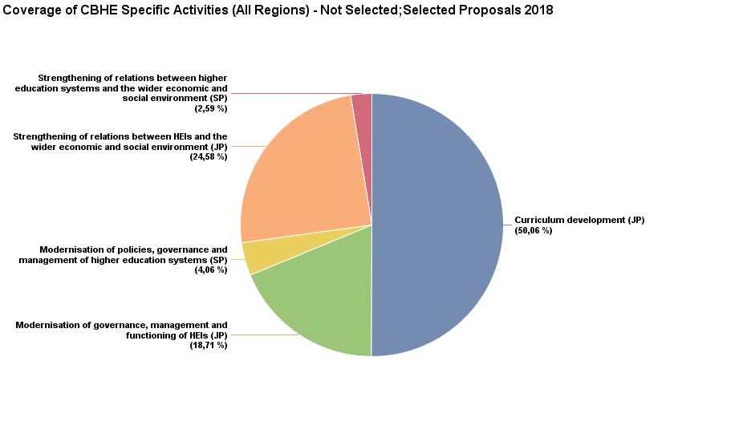
Coverage of the CBHE Specific Activities – all proposals 2018

Slide 14
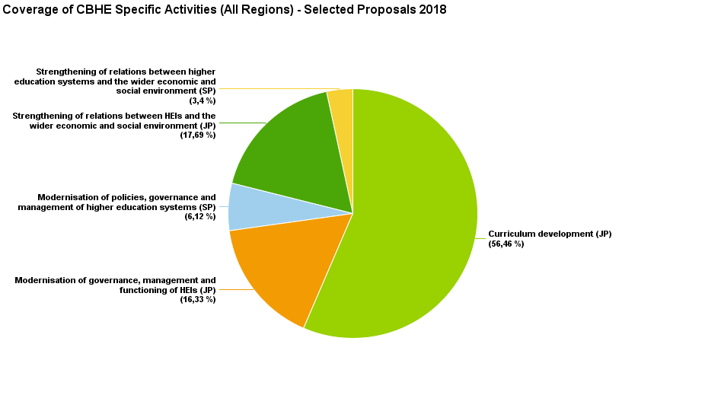
Coverage of the CBHE Specific Activities – Selected proposals 2018

Slide 15
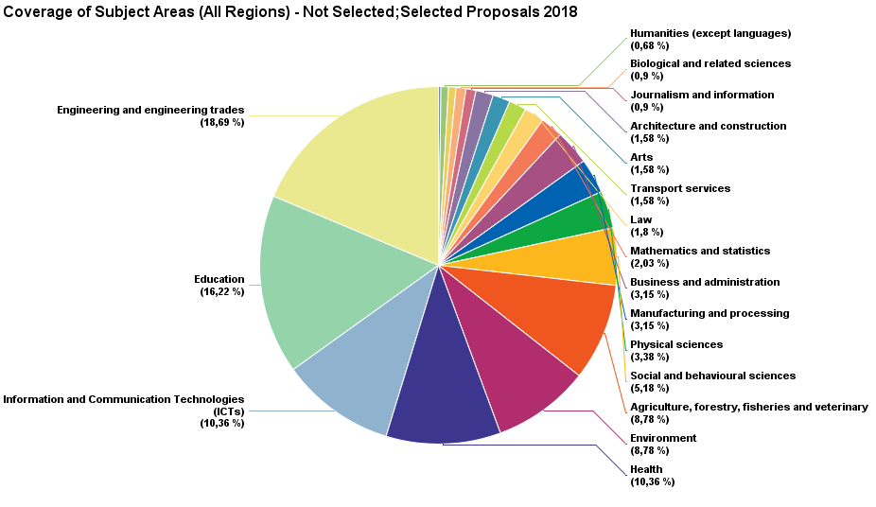
Coverage of Subject Areas– all proposals 2018

Slide 16
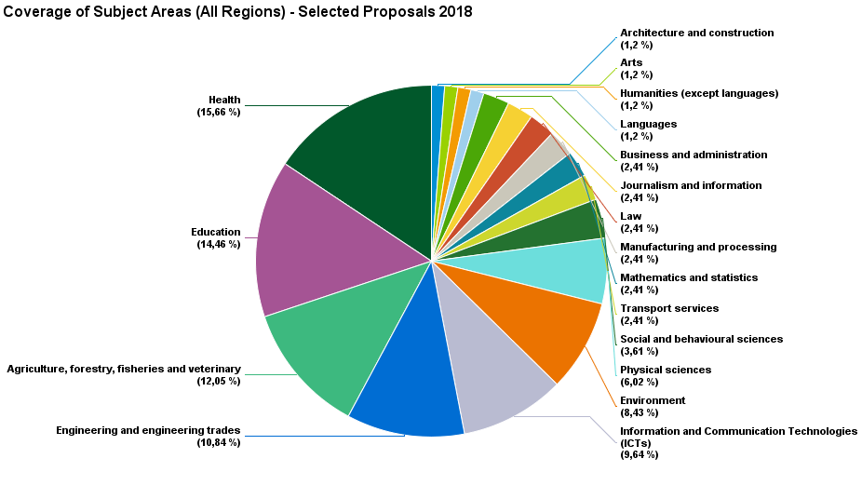
Coverage of Subject Areas– Selected proposals 2018

Slide 17
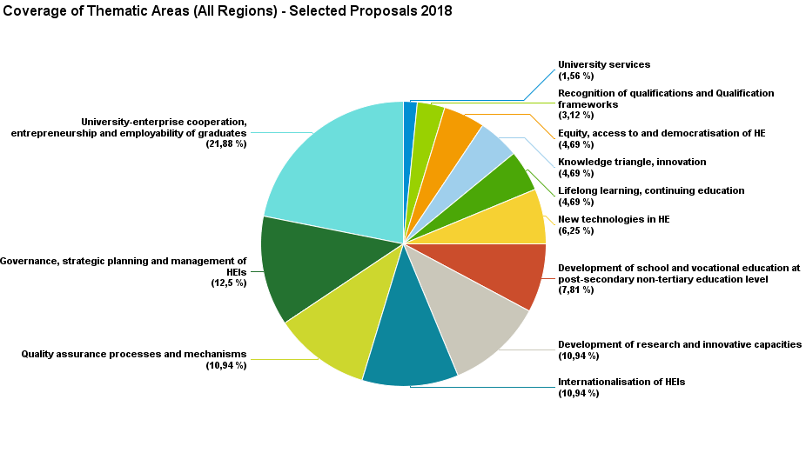
Coverage of Thematic Areas– selected proposals 2018

Slide 18
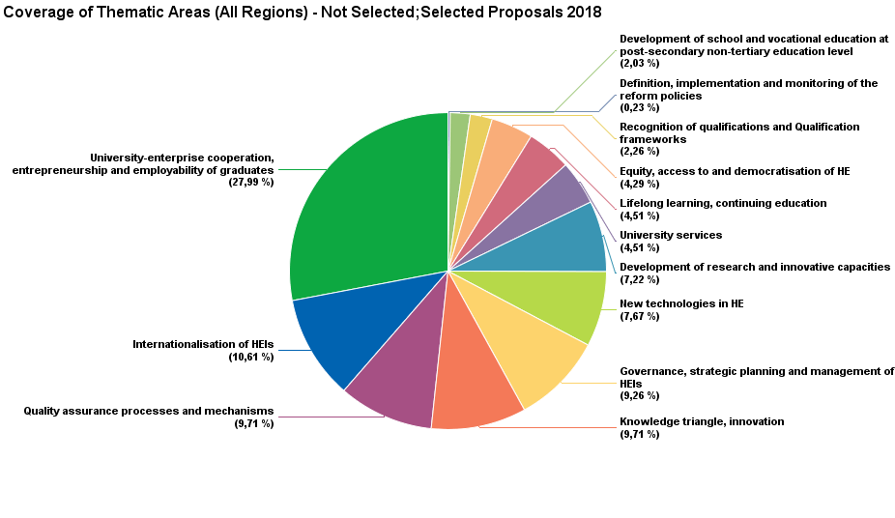
Coverage of Thematic Areas– all proposals 2018

Slide 19
Coverage of Thematic Areas– selected proposals 2018

Slide 20
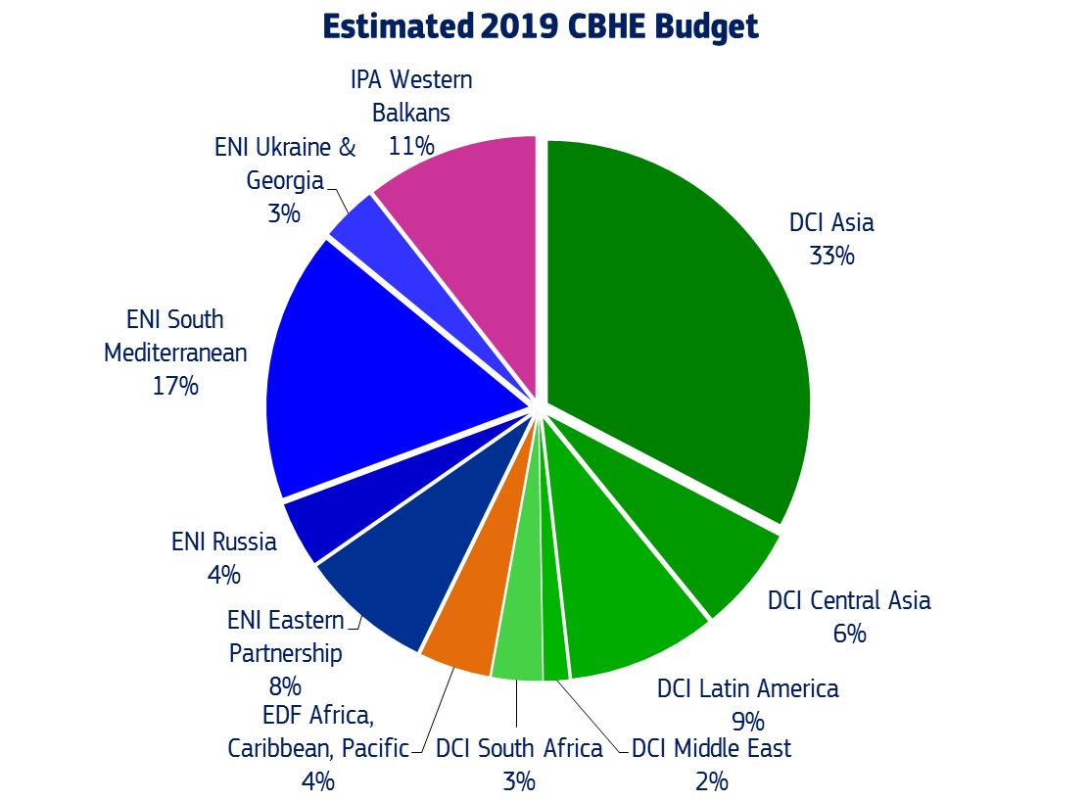
Indicative budget for 2019

Slide 21
Call for Proposals 2019
Indicative budget
Region | Budget allocated 2016 (in Mio €) | Budget allocated 2017 (in Mio €) | Budget allocated 2018 (in Mio €) | Budget allocated 2019 (in Mio €) | Indicative number of selected projects**
REGION 1 - Western Balkans | 13,17 | 13,82 | 14,57 | 16,39 | 19
REGION 2 - Eastern Partnership countries | 13,86 | 13,51 | 12,88 | 12,77 | 15
Additional allocation for Georgia/Ukraine* |  |  |  | 1/1 | 2
REGION 3 - South-Mediterranean countries | 28,57 | 27,84 | 26,55 | 26,17 | 30
Additional allocation for Tunisia* |  | 3,00 | 0 | 3 | 4
REGION 4 - Russian Federation | 6,89 | 6,72 | 6,41 | 5,85 | 7
REGION 6 - Asia | 35,38 | 39,55 | 41,44 | 47,46 | 54
REGION 7 - Central Asia | 9,2 | 8,80 | 8,80 | 9,42 | 11
REGION 8 - Latin America | 13,1 | 13,20 | 13,20 | 12,70 | 15
REGION 9 – Middle East (Iran, Iraq, Yemen) | 1,9 | 2,00 | 2,10 | 2,20 | 3
REGION 10 - South Africa | 3,42 | 3,91 | 4,20 | 4,50 | 5
REGION 11 - ACP countries | 5,29 | 5,64 | 6,00 | 6,35 | 7
TOTAL | 131,47 | 138,68 | 136,15 | 148,81 | 172
* An additional allocation for Tunisia/Georgia/Ukraine might become available subject to the relevant Commission decisions being taken. ** Calculated on the average grant/project recorded in 2018

Slide 22
News in the 2019 Call for proposals
British Applicants must be aware that eligibility criteria must be complied with for the entire duration of the grant agreement
The Republic of Serbia will take part as a Programme Country (if the conditions are fulfilled)
Chile and Uruguay are not considered as eligible Partner Countries in CBHE anymore
Ukraine and Georgia have been awarded 1 extra million €/each
Tunisia has been awarded 3 extra million €
Revision of the "Detailed description of the project (Annex 1)

Slide 23
Key messages for 2019 (I)
Encouraging the cooperation with Asian countries
Diversification of projects
Attention to national and regional priorities
National and regional relevance in cross-regional applications
Migration, a Commission priority for President Juncker
Attention to eligibility criteria
Attention to the coherence of the information provided in the application form, in particular in the "Detailed description of the project (Annex 1)

Slide 24
Key messages for 2019 (II)
Special attention will be given to proposals:
Involving the least developed countries
Involving universities in more remote areas
Targeting disadvantaged students from poor socio-economic backgrounds
Targeting students with special needs

Slide 25
Roadmap for 2019 CBHE Call
Steps | Date
Publication Erasmus+ CBHE Call for Proposals | 24 October 2018
Deadline for submission of applications | 7 February 2019
Verification of eligibility of project proposals | February – March 2019
Assessment of projects by experts (remotely) | March – May 2019
Consultation procedure | June 2019
Evaluation Committee for selection of projects | July 2019
Sending for signature of Award decision by Agency AO | July 2019
Notification of applicants & publication of results | August 2019
Preparation and signature of grant agreements | August-September 2019
Start of eligibility period | 15 November 2019 or 15 January 2020
Erasmus+

Slide 26
CBHE Information sources (I)
Erasmus+ website - EACEA
http://eacea.ec.europa.eu/erasmus-plus/actions/key-action-2-cooperation-for-innovation-and-exchange-good-practices/capacity-0_en
Erasmus+ website – EU Commission
http://ec.europa.eu/programmes/erasmus-plus/index_en.htm
Study in Europe website:
http://ec.europa.eu/education/study-in-europe_en
Erasmus+ e-tutorials:
https://eacea.ec.europa.eu/erasmus-plus/introduction-international-dimension-erasmus-plus_en

Slide 27
CBHE Information sources (II)
International E+ International Contact Points (ICPs) in Programme Countries
https://eacea.ec.europa.eu/erasmus-plus/contacts/international-erasmus-plus-contact-points_en
National Erasmus+ Offices (NEOs) in certain Partner Countries (PCs)
https://eacea.ec.europa.eu/erasmus-plus/contacts/national-erasmus-plus-offices_en

