Slide 1
Impact of Capacity building projects via quality assurance and other tools
Rikhsieva Gulchehra
HERE, TSIOS

Slide 2
HIGHLIGHTS of HERE Annual Conference “Capacity building for higher education reform: The impact of collaborative international projects’’ 11-13 December 2018, Rome, Italy
https://supporthere.org/rome2018

Slide 3
Aim of the HEREs Annual Conference:
To examine models of international collaboration and specifically how collaborative capacity building projects can have structural impacts on higher education institutions as well a national education policies
To both compare and seek synergies between projects that have similar objectives and address similar reform themes, such as quality assurance, recognition, employability, governance, autonomy, mobility and internationalisation
To allow HERE to share results of such projects but also discuss ways of maximising impact on policy reform
To demonstrate in particular the role of projects in contributing to the Bologna Process implementation

Slide 4
CBHE in Erasmus+
Partnerships
Modernising
Internationalising
Quality & Relevance
Impact

Slide 6
CBHE impacts
Individual
HR Capacity of Academic staff
HEI
Benefit to Admin Staff
Labour market skills for students
Curriculum diversity
International visibility
New tools – QA, Monitoring, etc
IRO set up

Slide 7
CBHE impacts
National/Regional
International
Concrete Internationalisation plans
Enhanced collaboration
Modernisation of HE
Increased autonomy
Better labour market relations
Tangible objectives

Slide 8
some posters of CBHE projects

Slide 9
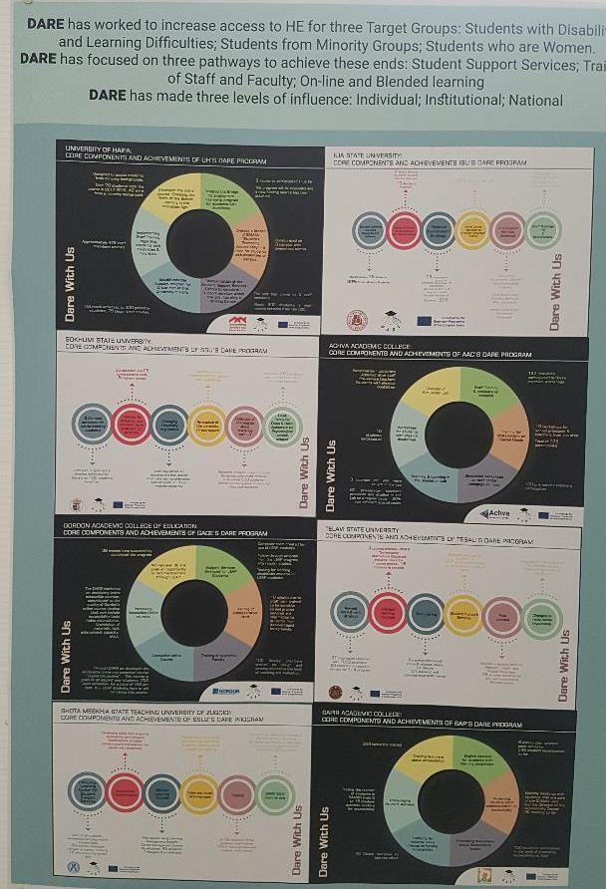

Slide 10
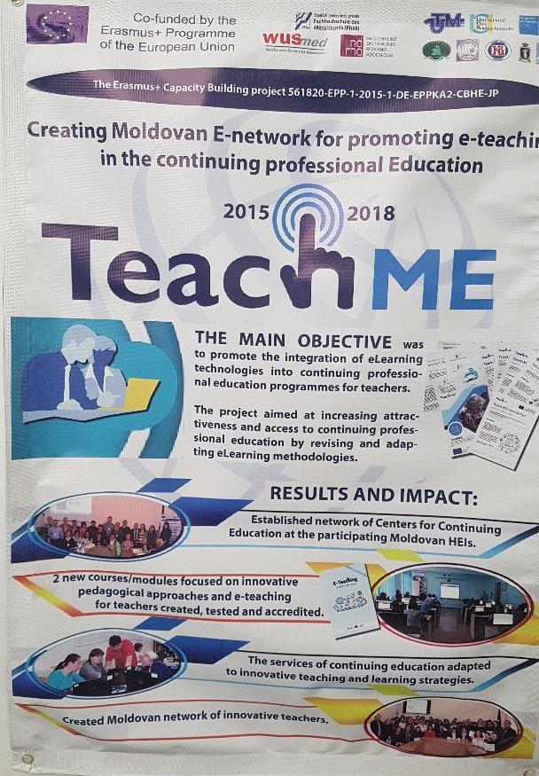

Slide 11
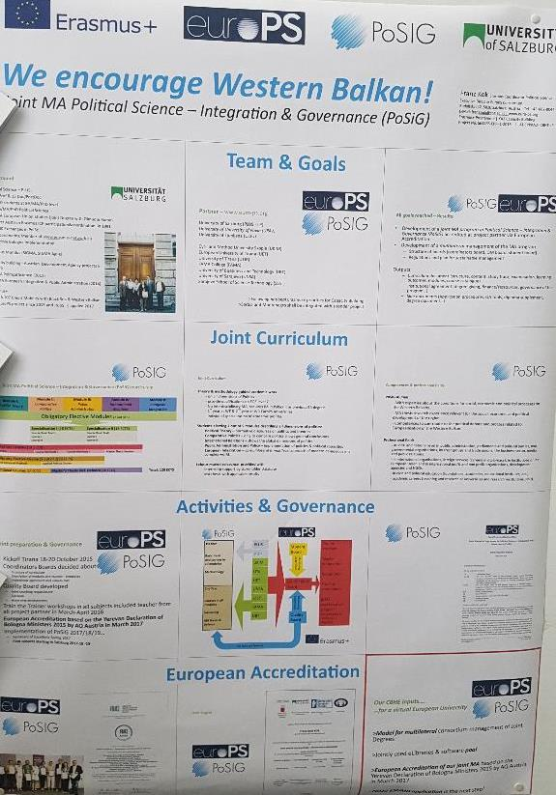

Slide 12
Recommendations of European Commission for improvements
Less individual approaches, more institutional ownership
Involvement of new & smaller institutions
Inclusiveness (individual & institutional)
Structural measures with Ministries
Dissemination, valorisation, spillover to national level

Slide 13
Recommendations for building up the capacities of universities
• Need to develop a strategic approach towards university management
Need to develop managerial skills at the level of
university leadership
Need to establish/strengthen the intermediate level of management, overcoming excessive segmentation of university structure
Need to provide career paths for the young generation (academics and administrators)

Slide 14
Parallel regional round tables: Capacity building projects and the implementation of major policy and reform goals
Group 1: Recognition and qualifications frameworks
Group 2: Quality assurance reform
Group 3: Mobility
Group 4: Teaching and learning reform
Discussions in break out groups: Social inclusion

Slide 15
Some conclusions of Uzbek HEREs
Think global act global and contribute local as a new slogan of the future Erasmus+ Programme!
The level of an uncertainty in the world is raised dramatically! Bologna Process make a small but evident impact to decreasing of this level that leads to more peace and benefited all the countries even which just join this initiative!
The knowledge without borders will be and actually already is reality for all of us!
The Bologna Process is unique but providers of its principles are different and all of them are acceptable!

Slide 16
Useful links:
https://supporthere.org/rome2018/page/presentations-conference-rome-2018
https://supporthere.org/sites/default/files/rome_december_2018_claire.pdf
https://supporthere.org/sites/default/files/12-12-2018_sphere_conference_rome_-_plenary_1_-_outcomes_of_the_2018_bologna_ministerial_conference_and_the_peer_learning_approach_-_michael_gaebel.pdf
https://supporthere.org/sites/default/files/12-12-2018_sphere_conference_rome_-_plenary_2_-_principle_and_recommendations_for_governance_reforms_-_enora_pruvot.pdf

Slide 17
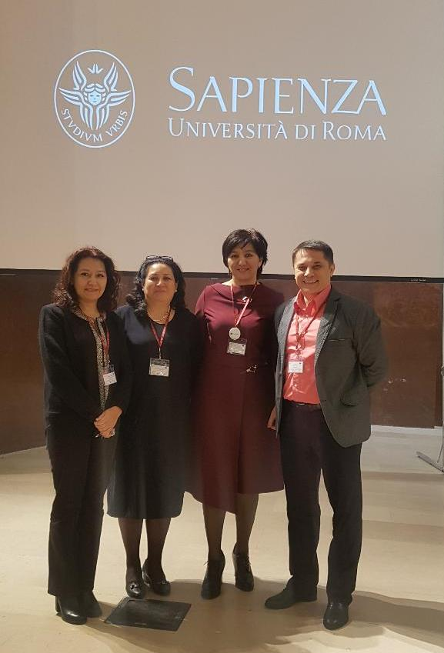
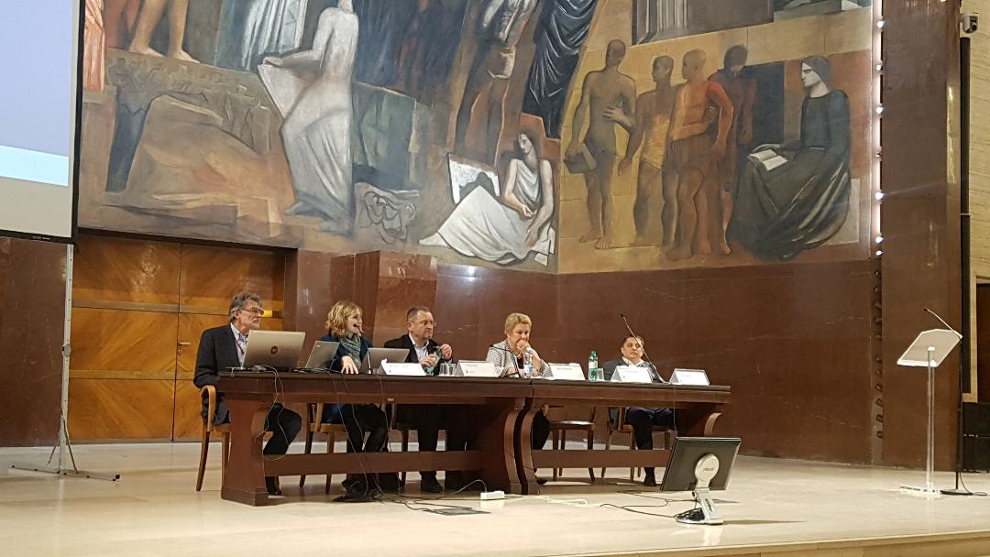
THANK YOU! gulchehra_rihsieva@yahoo.com

